Slide 1

Diphthongs: Two Vowels, One Sound!
Welcome to our exciting journey into the world of diphthongs! Today, we'll discover how two vowel sounds can join together to create one magical sound in a word. This primary-level English lesson will help you master these special vowel combinations through fun examples and activities.

Slide 2
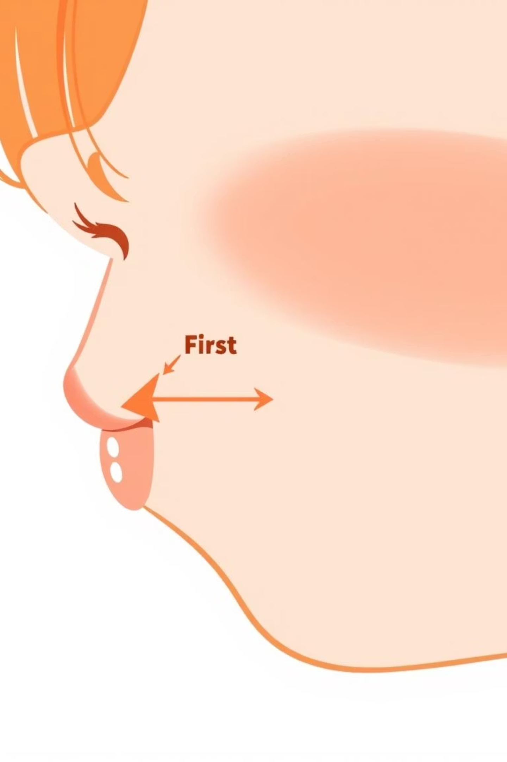
What Exactly is a Diphthong?
Definition
Simple Way to Remember
A diphthong occurs when two vowel sounds come together to make one sound in a word. It's still considered just one syllable.
Think of it as: "Two vowels, one sound." Like two friends becoming one super-friend with special powers!
Examples
Words like rain, boy, and cow all contain diphthongs. Notice how your mouth moves when you say these words!

Slide 3
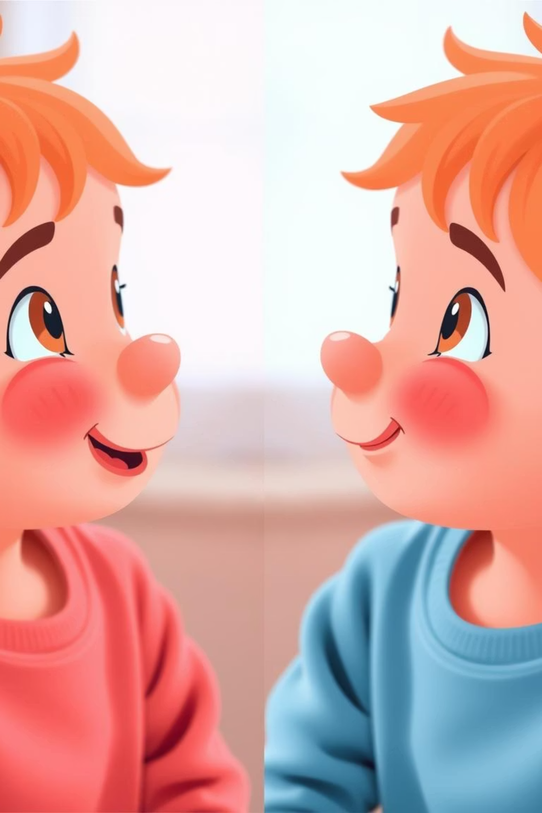
Normal Vowels vs. Diphthongs
Normal Vowels (One Sound)
Diphthongs (Two Sounds Together)
When you say these words, your mouth stays in pretty much the same position:
When you say these words, your mouth moves during the vowel sound:
rain - your mouth changes position during "ai"
cat - your mouth stays in one position for the "a"
boy - feel how your mouth moves during "oy"
pen - the "e" sound doesn't change
dog - the "o" sound is steady
cow - notice the movement during "ow"
Try saying these words slowly and notice how your mouth barely moves during the vowel sound!
It's like your mouth is doing a mini dance during the vowel sound!

Slide 4
The Diphthong Family
1
2
/eɪ/ Sound
/aɪ/ Sound
Found in: day, rain, play
Found in: time, cry, light
Your mouth moves from "eh" to "ee" position.
Your mouth moves from "ah" to "ee" position.
Try saying: "Hey, I made a cake today!"
Try saying: "My kite flies high in the sky!"
3
4
/ɔɪ/ Sound
/aʊ/ Sound
Found in: boy, toy, coin
Found in: cow, house, mouth
Your mouth moves from "aw" to "ee" position.
Your mouth moves from "ah" to "oo" position.
Try saying: "The boy enjoys his noisy toys!"
Try saying: "Wow! A brown cow is around our house!"

Slide 5

More Diphthong Friends
1
2
/oʊ/ Sound
/ɪə/ Sound
Found in: go, nose, boat
Found in: ear, near, clear
Your mouth moves from "oh" to "oo" position.
Your mouth moves from "ih" to "uh" position.
Try saying: "Don't throw snow from your boat!"
Try saying: "I can hear the deer coming near!"
3
4
/eə/ Sound
/ʊə/ Sound
Found in: hair, chair, fair
Found in: sure, tour, pure
Your mouth moves from "eh" to "uh" position.
Your mouth moves from "oo" to "uh" position.
Try saying: "Be careful with that chair over there!"
Try saying: "I'm sure the tour will be pure fun!"

Slide 6






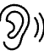

Spot the Diphthong Challenge!
Can you find the diphthong in each of these words? The diphthong parts are highlighted for you:
rain
cry
The "ai" makes the /eɪ/ sound
The "y" makes the /aɪ/ sound
boy
house
The "oy" makes the /ɔɪ/ sound
The "ou" makes the /aʊ/ sound
snow
chair
The "ow" makes the /oʊ/ sound
The "ai" makes the /eə/ sound
ear
sure
The "ea" makes the /ɪə/ sound
The "u" makes the /ʊə/ sound

Slide 7
Fun Activities to Master Diphthongs
1. Listen and Repeat
2. Fill in the Missing Letters
Let's practice saying these diphthong words together:
Can you complete these words with the correct diphthong?
day - Feel your mouth move from "eh" to "ee"
r__n (hint: water falls from the sky)
cow - Feel your mouth move from "ah" to "oo"
b__ (hint: not a girl)
boy - Feel your mouth move from "aw" to "ee"
h__se (hint: where you live)
snow - Feel your mouth move from "oh" to "oo"
sn__ (hint: cold and white)
Try saying these words in a silly voice or while making funny faces! The more bizarre, the more memorable!
ch__r (hint: you sit on it)
Answers: rain, boy, house, snow, chair

Slide 8
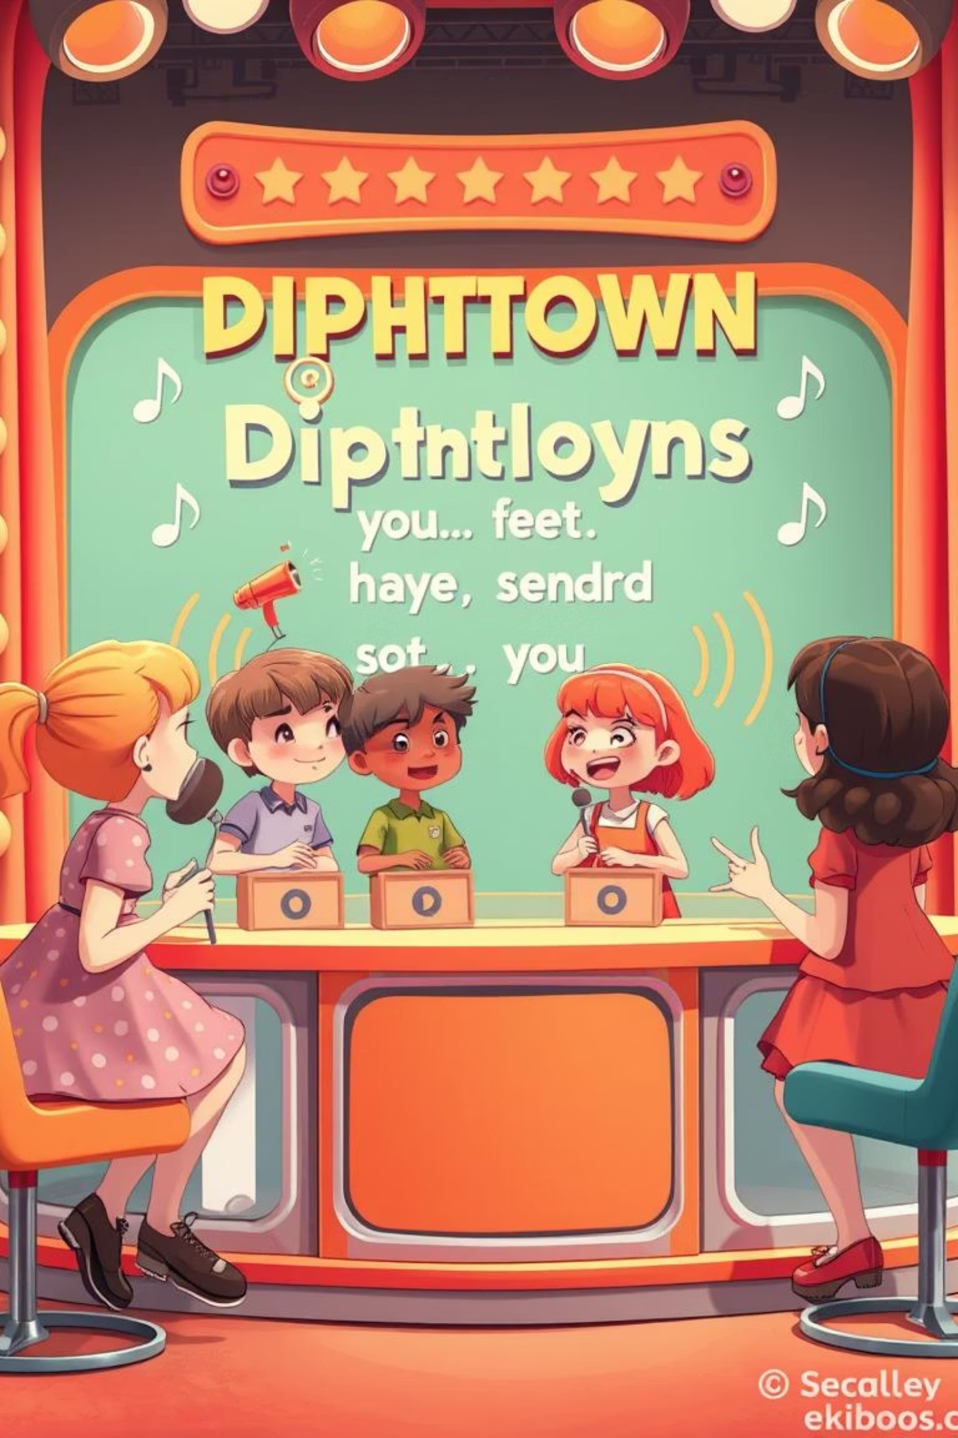



Quick Practice: Spot the Diphthong!
Circle the word in each pair that contains a diphthong. Remember, diphthongs are when two vowel sounds join to make one sound!
1. sun / boy
"Boy" has the /ɔɪ/ diphthong!
In "sun," the "u" makes just one sound.
2. cat / rain
"Rain" has the /eɪ/ diphthong!
In "cat," the "a" makes just one sound.
3. dog / cow
"Cow" has the /aʊ/ diphthong!
In "dog," the "o" makes just one sound.
4. pen / snow
"Snow" has the /oʊ/ diphthong!
In "pen," the "e" makes just one sound.
5. bed / chair
"Chair" has the /eə/ diphthong!
In "bed," the "e" makes just one sound.

Slide 9













Remember These Diphthong Facts!
The Diphthong Rule
A diphthong is when two vowels come together to make one sound.
/eɪ/
/aɪ/
rain, day, play
time, light, cry
/ɪə/, /eə/, /ʊə/
/ɔɪ/
ear, hair, sure
boy, toy, coin
/oʊ/
/aʊ/
go, snow, boat
cow, house, mouth
👉 Easy to say, easy to see!

Slide 10

Homework: Create Your Own Diphthong Collection!
Write two words for each of these diphthongs. Be creative and try to think of words we haven't used in class!
/eɪ/ Sound
/aɪ/ Sound
/ɔɪ/ Sound
Examples: cake, train, say, wait
Examples: kite, smile, night, fly
Examples: noise, voice, join, soil
Your turn: __________, __________
Your turn: __________, __________
Your turn: __________, __________
/aʊ/ Sound
/oʊ/ Sound
Examples: cloud, town, crown, flower
Examples: home, grow, flow, toast
Your turn: __________, __________
Your turn: __________, __________
Remember: The more bizarre or funny your examples, the easier they'll be to remember! Try creating a silly sentence using your diphthong words.

